Slide 1
DSCI 2411 · Data Visualization
What Makes People Happy?
A Global Analysis of Happiness Drivers
Farah Sabri · Seif Eltahmoudi · Karim Nashed
Spring 2026 · The American University in Cairo
Opening
Challenge
Action
Resolution

Slide 2
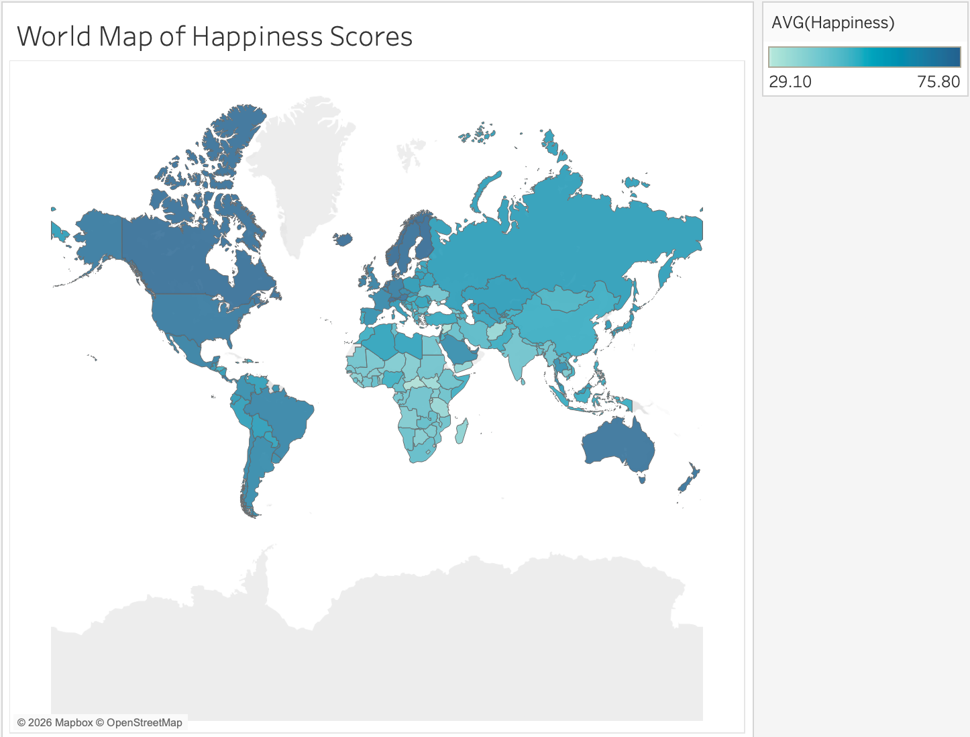
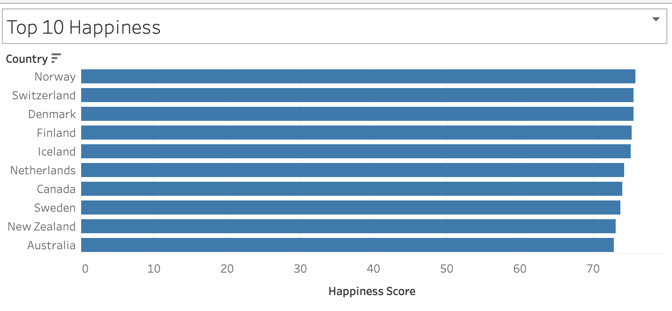
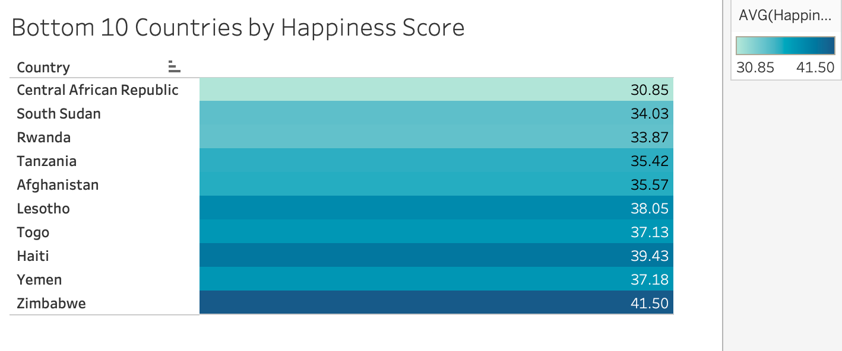
Where Are People Happy? (World Map 2012–2017)
Opening
Global Pattern
Happiness clusters geographically, it is shaped by national conditions, not chance.
Darker = Happier
Northern Europe · North America · Oceania
Lighter = Less Happy
Sub-Saharan Africa · Conflict regions
This raises the question: what explains the gap?
Top 10 — Happiest
Bottom 10 — Least Happy

Slide 3
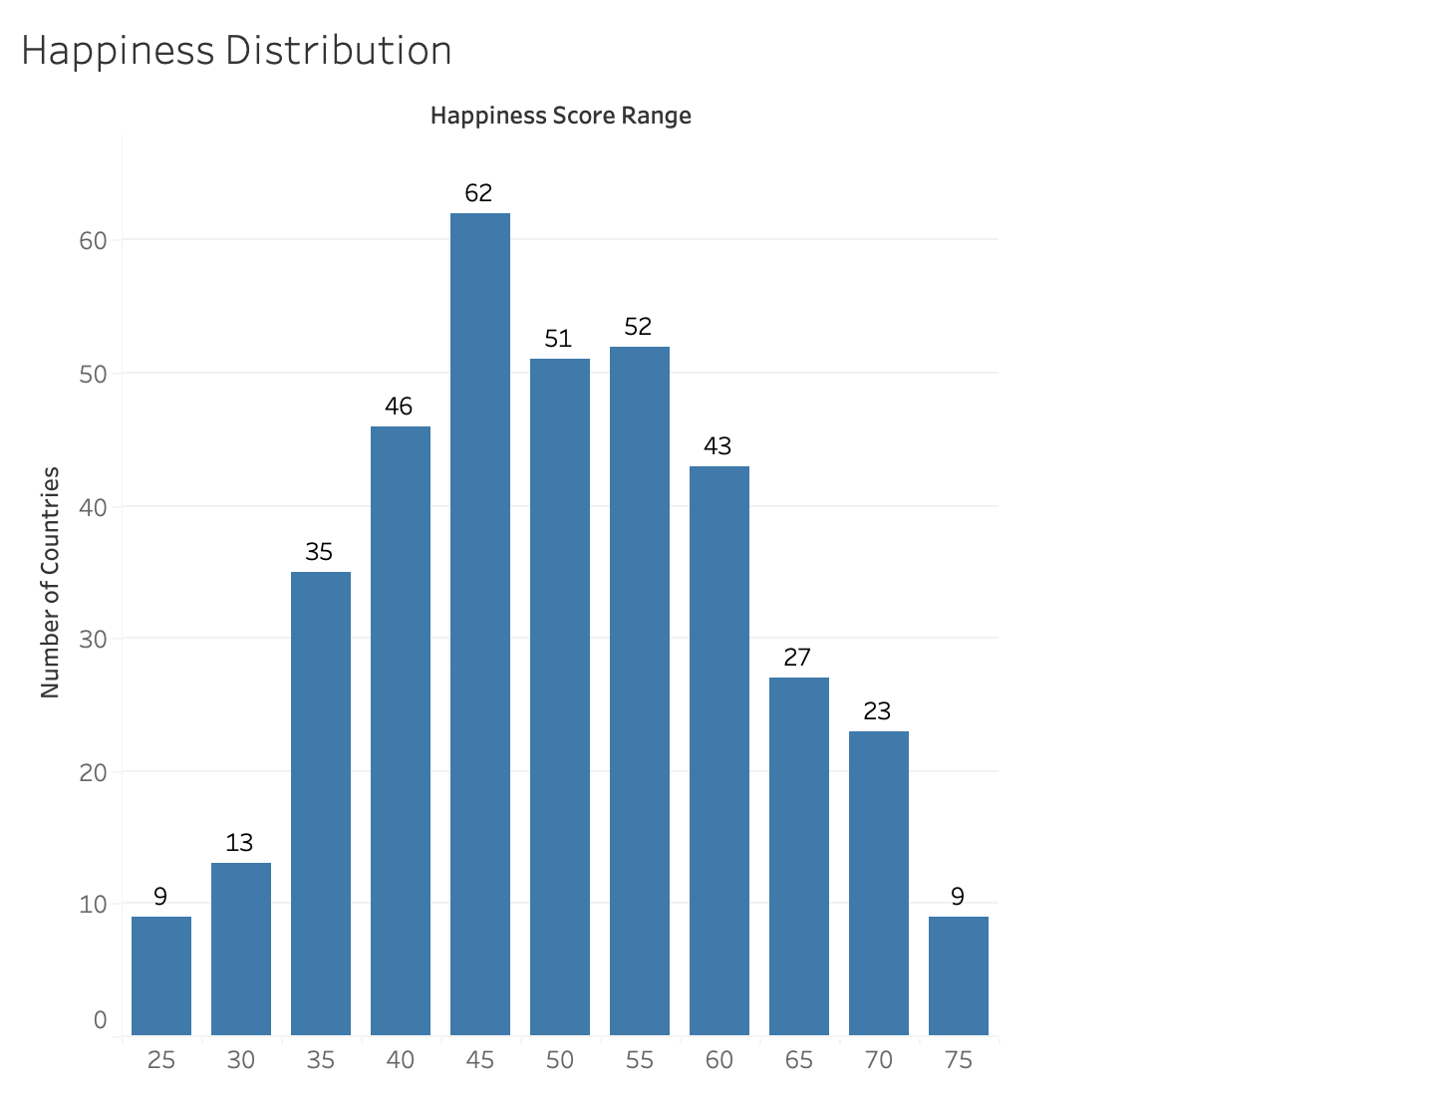
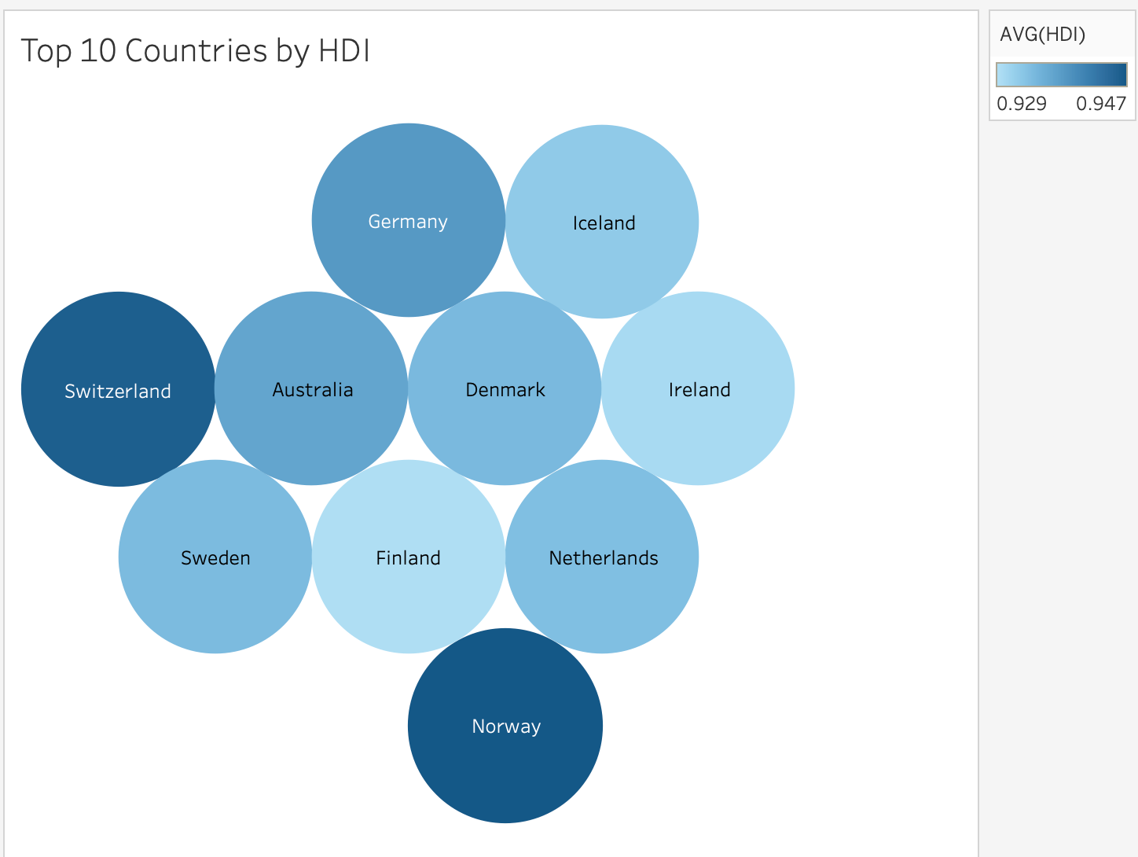
Opening - How Is Happiness Distributed? (2012–2017)
Opening
Happiness Distribution
Top 10 Countries by HDI
Most countries fall in the middle range (45–60). The same nations dominate both the happiness and HDI top 10, Finland, Denmark, Switzerland, Sweden, Netherlands. Coincidence?

Slide 4
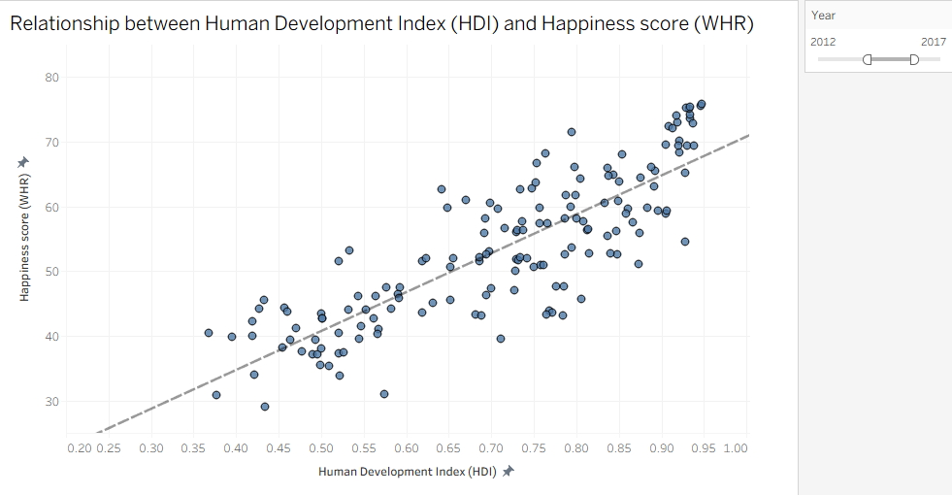
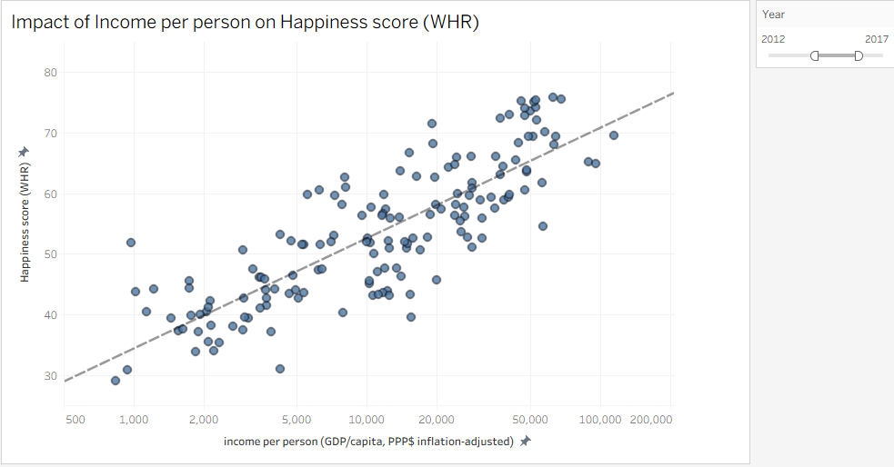
Factor 1 & 2: HDI and Income vs. Happiness
Challenge
HDI vs. Happiness
Income vs. Happiness (log scale)
R-squared = 0.7027
P-Value < 0.0001
Both show clear positive trends. HDI is the stronger signal. Income matters but with diminishing returns, once basic needs are met, extra wealth adds less happiness.

Slide 5
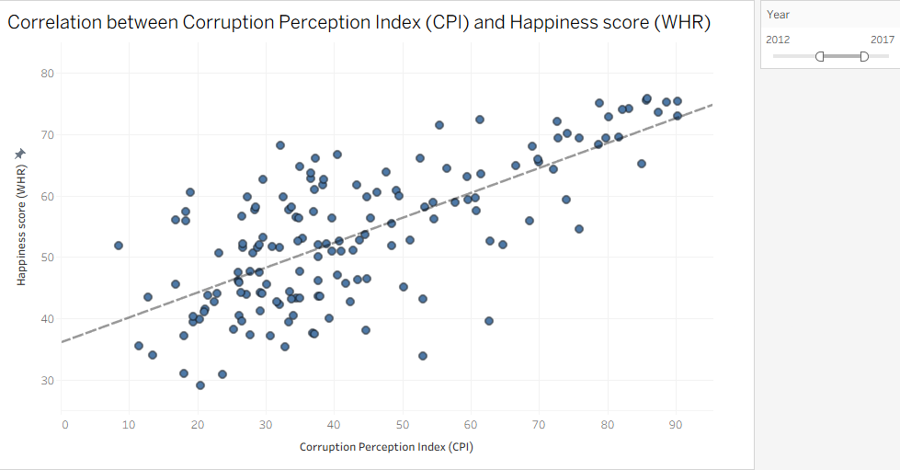
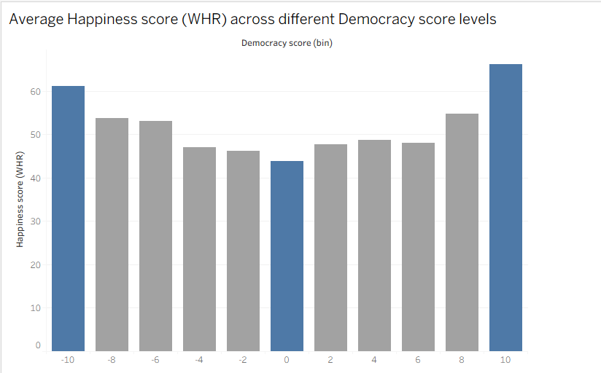
Factor 3 & 4: Corruption and Democracy vs. Happiness
Challenge
CPI vs. Happiness
Democracy Score vs. Happiness
Lower corruption → more happiness. Democracy is surprising: full democracies rank highest (66.2) but strong autocracies (61.2) beat hybrid regimes. Stability matters more than regime type.

Slide 6
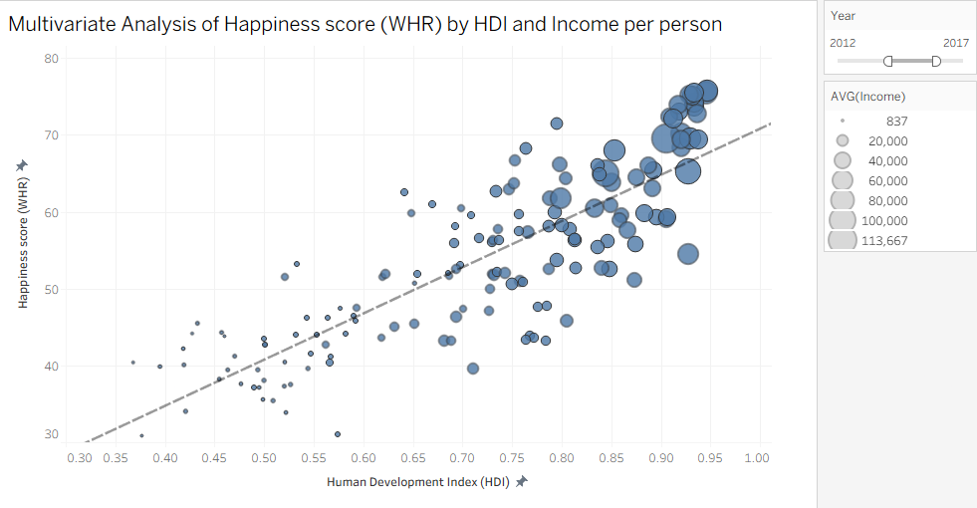
Combining HDI × Income: The Multivariate Picture
Challenge
R² = 0.70
HDI explains 70% of happiness variation (p < 0.0001)
Bubble size = Income
Largest bubbles cluster top-right, high HDI AND high income = highest happiness.
Development + income together are the most powerful predictors of national happiness.

Slide 7
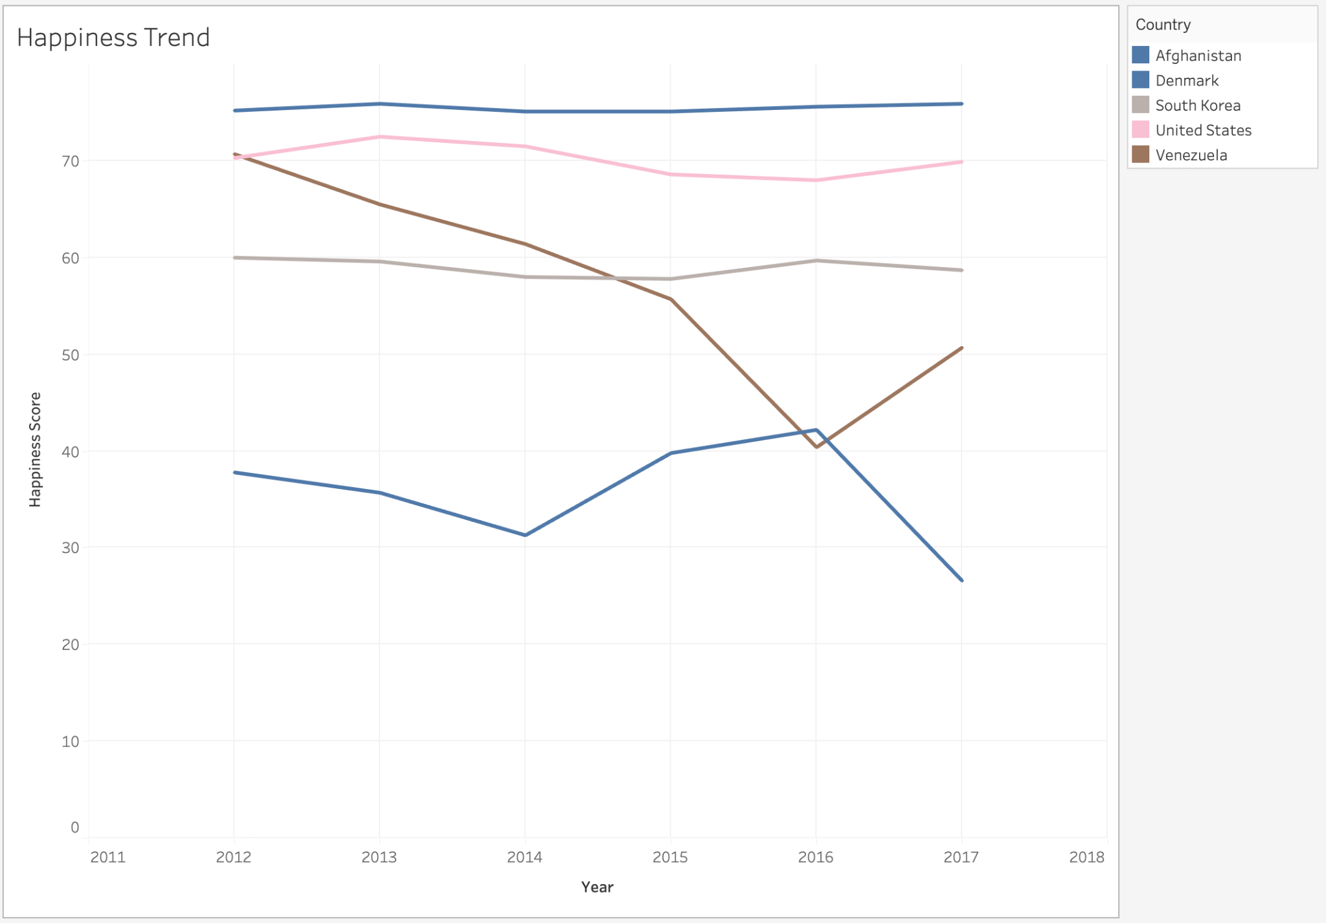
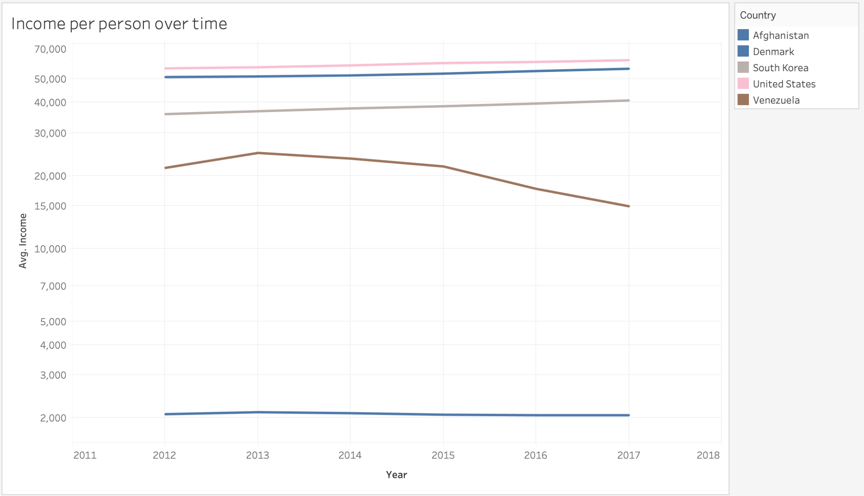
Change over Time: Happiness & Income (2012–2017)
Action
Happiness Trend
Income per Person
Venezuela: happiness and income crash simultaneously from 2014, institutional decay in real time. Denmark stays near the top; South Korea steadily climbs. Afghanistan anchors the bottom throughout.

Slide 8
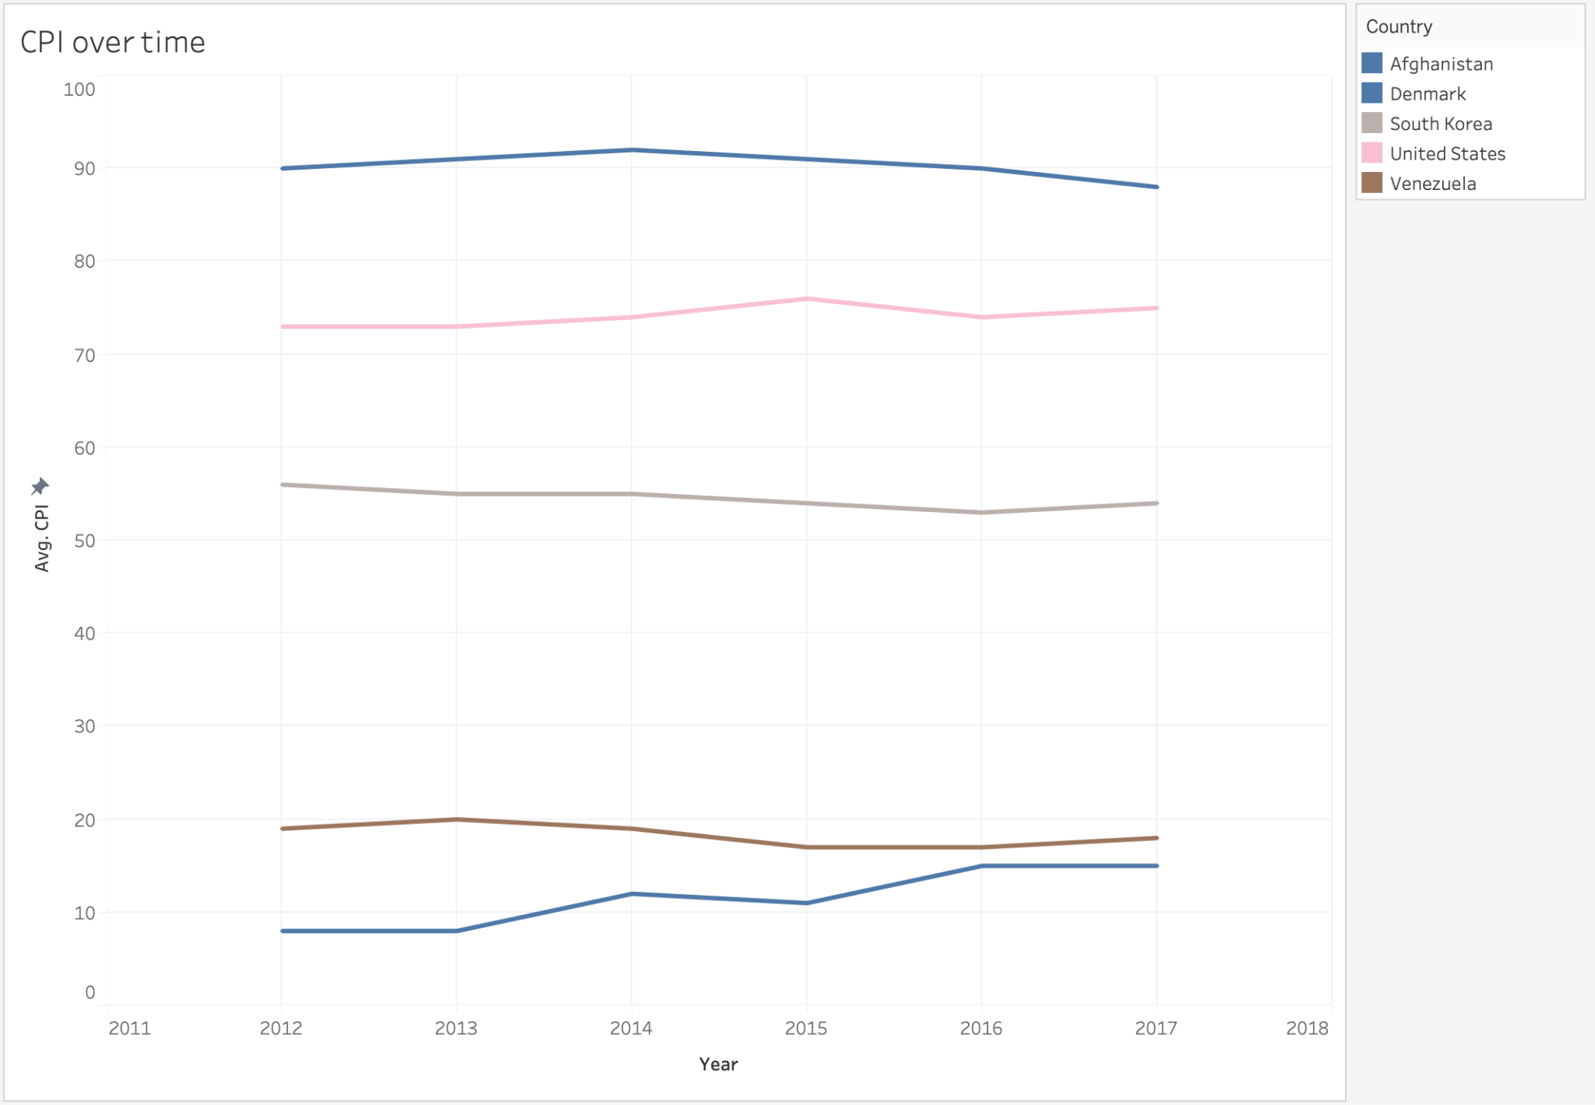
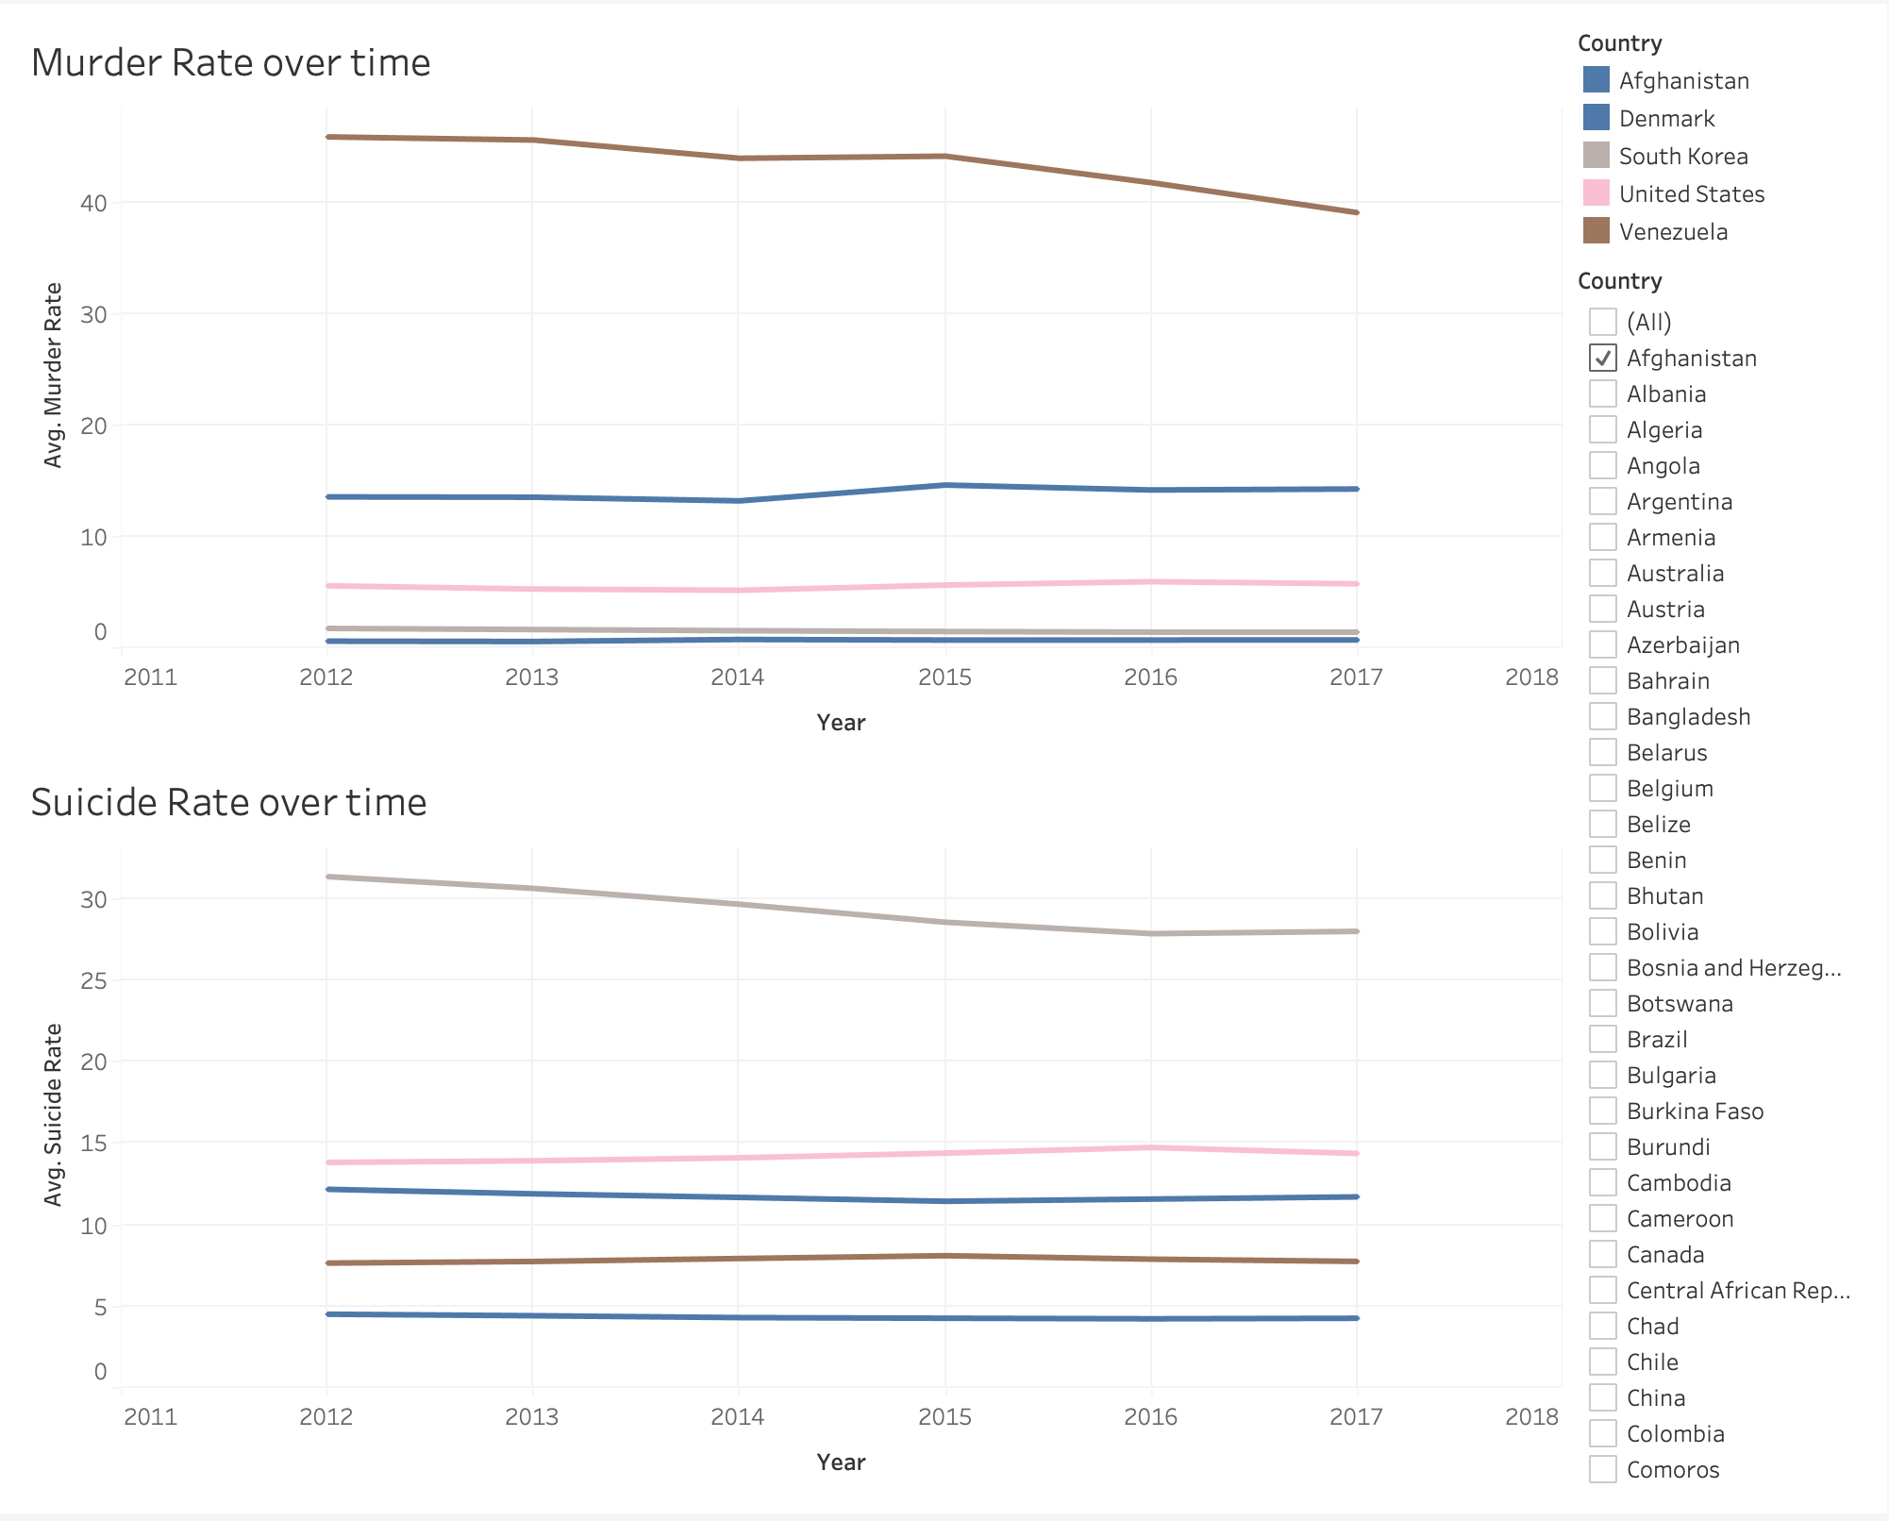
Corruption over Time & The Safety Paradox
Action
CPI over Time
Murder vs. Suicide Rate over Time
Corruption barely moves, it is deeply systemic. The prosperity paradox: South Korea leads suicide rates despite high HDI, wealth prevents violence but not internal pressure.

Slide 9
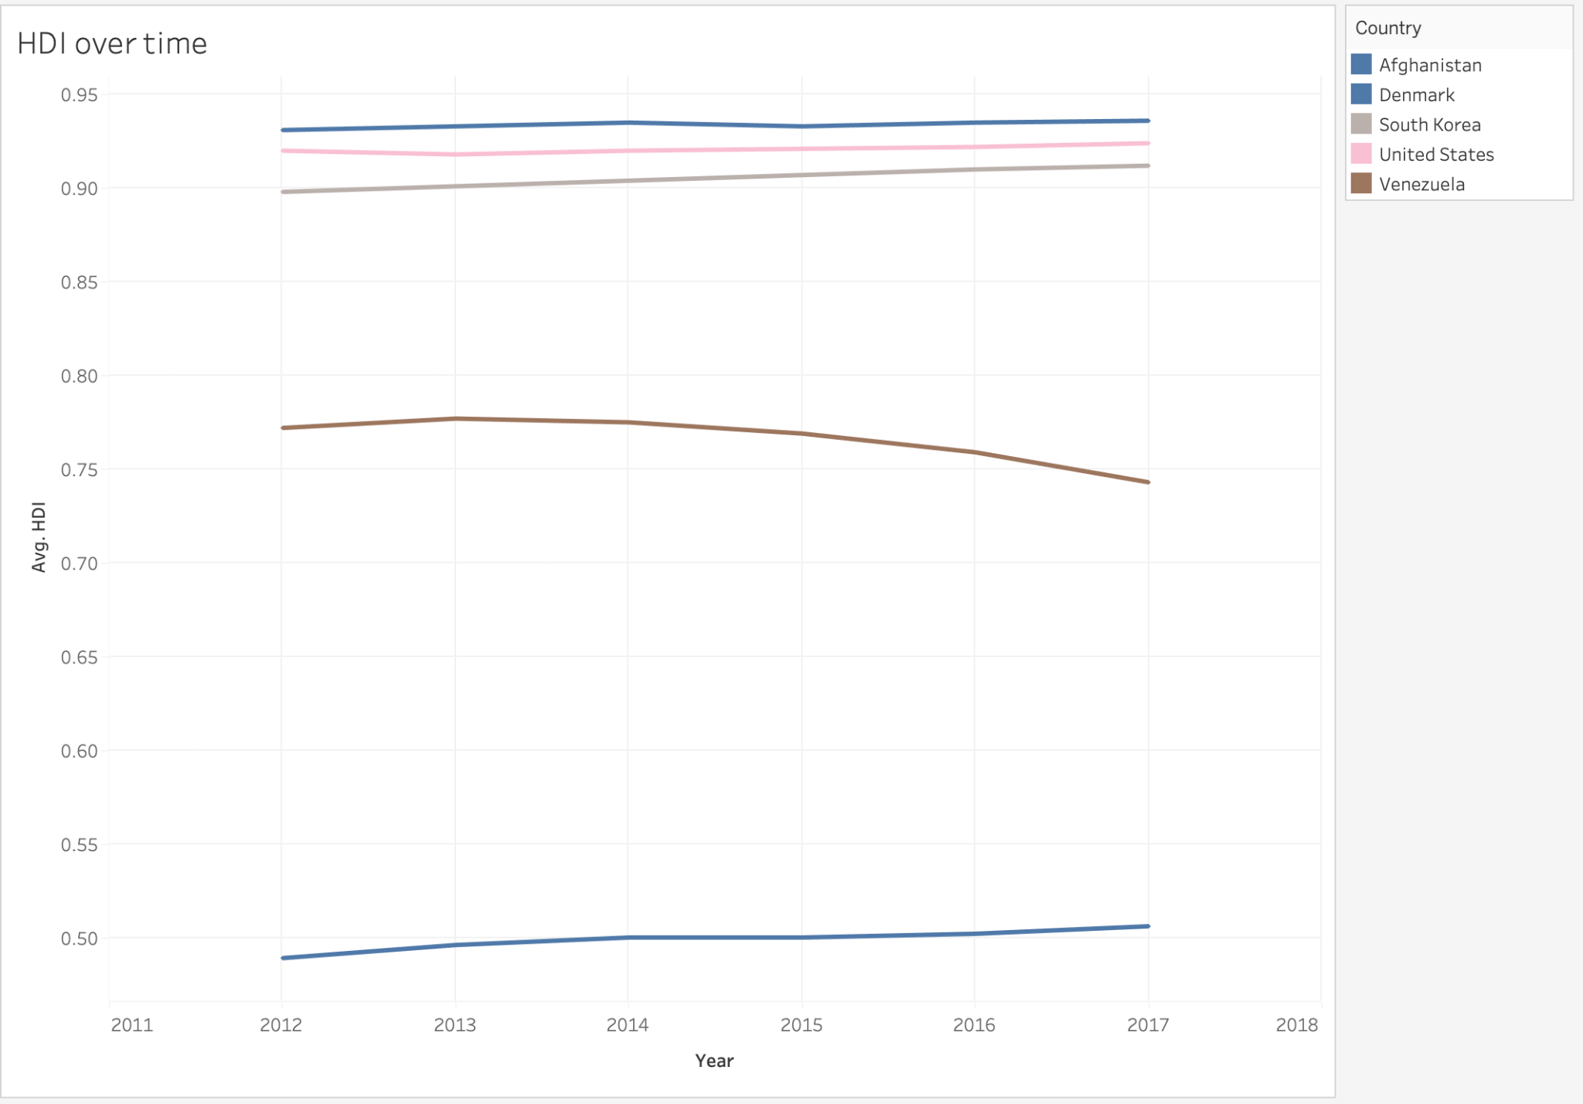
HDI over Time: Development Trajectories (2012–2017)
Action
Five Archetypes
Denmark / US
Slow, stable growth: mature democracies
South Korea
slight upward climb
Venezuela
HDI flatlines mid-decade: a leading indicator of collapse before the economy fully crashed
Afghanistan
Persistently low throughout

Slide 10
The Hierarchy of Happiness Drivers
Resolution
#1
#2
#3
#4
HDI
Income
Corruption (CPI)
Democracy
R² = 0.70
Strong positive
Meaningful link
Non-linear
★★★★★
★★★★☆
★★★☆☆
★★☆☆☆
Core Finding: National happiness is most powerfully driven by human development (health, education, living standards) and economic welfare. Countries that invest in these, while maintaining institutional integrity, consistently achieve the highest happiness scores. Governance stability matters more than regime type alone.

Slide 11
CONCLUSION
Happiness is Built, Not Born
HDI (health, education, living standards) is the strongest predictor: R² = 0.70
Income matters significantly, but with diminishing returns at higher wealth levels
Corruption erodes happiness; transparency and public trust are critical
Stability trumps regime type — institutional decay destroys well-being rapidly
The prosperity paradox: high development does not automatically prevent mental health crises
Spring 2026 · DSCI 2411 · The American University in Cairo

